Slide 1
“The Effect of Computerized Test Accommodation on the Middle School Mathematics Performance of the English Language Learners

Slide 2
Rational of The Study
The mathematics performance of middle and high school English language learners are lower than their counterparts (National Assessment of Educational Progress, 2015). ELs need language-support accommodations in taking the standardized math assessments.
The National Research Council (NRC, 1999a) reached the conclusion that “research on the effects of test accommodations for English-language learners is inconclusive” (p. 62). The Inconclusive findings from the previous studies found the effects of accommodations on reading comprehension tests.
Computer-based assessments and the embedded accommodations make the EL accessible to the popular accommodations and benefit their math test. However, little empirical research with Computer-based assessments.

Slide 3
Research Questions
Are the accommodations effective for increasing the mathematics performance of the EL students in standardized assessment?
Are there any different across “Linguistic Modified” and “English-Glossary” regarding the accommodations effect on mathematics performance used by ELs, after controlling for SBAC test scores, English Language Proficiency levels, and ETIMER scores?
Do the accommodations have construct validity without altering the non-EL students’ performance.
What is the relationship between the using “Linguistic Modified” and “English-Glossary” accommodation and the response time by the ELs?
Notes:
Do the accommodations have construct validity without impact the non-EL students’ performance.
Are there any differences across “Linguistic Modified”, “ English Read-aloud” and “English-Glossary” accommodations with respect to the effect on middle school mathematics performance used by ELs and non-ELs?
Are the accommodations effective for increasing the mathematics performance of the EL students in standardized assessment?
What is the relationship between response time and accommodation status between the ELs and non-Els?

Slide 4


Develop the Computer-based Accommodation System
Diagnosis
English Spanish
English TIMER
Non-accommodated
Linguistically Modified Version
English
Glossaries
Spanish TIMER
Non-accommodated
Read-aloud Version
Student A
Student B
Student C
Student D
Notes:
ETS comments: The original chart does not match with our study – the original chart reads as if students had to pass through either the English or Spanish math test to get to a particular version (also there is a mix of version/option here). Instead our design was more that we had 6 options - and students could be assigned to either the standard form or the 3 English accommodations, or the Spanish version (or standard form) with the bilignual glossary as another version. We revised some wording here to fix this, but still this chart is not accurate to reflect our design. We suggest Yu rather show this chart very quickly and doesn’t spend too much time on this slide, just quickly give the audience a visual representation of our design.

Slide 5
Instrument Development
30 items of multiple-choice questions with three accommodation versions were selected to be in the final version of the mathematics assessment.
Non-accommodated version, Cronbach alpha = .67.
Linguistic-Modified version Cronbach alpha =.70.
English-Glossary Cronbach alpha = .71.
The English Readaloud was dropped due to the small sample size.
Notes:
Somewhat low. This test needs to be supplemented by other measures (e.g., more tests) to determine grades. There are probably some items which could be improved.

Slide 6
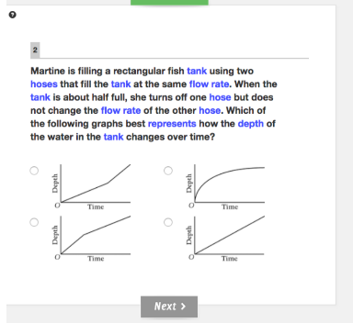
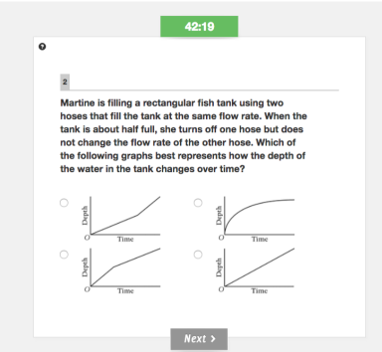
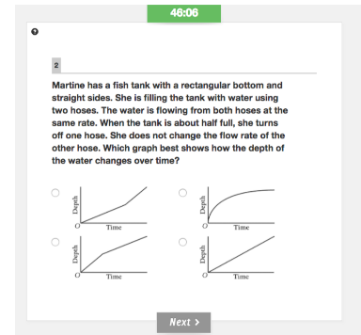
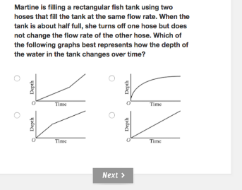
Samples of the Accommodation
Non-accommodated
English Glossary
Linguistic-Modified
Read-aloud-version

Slide 7
Test Development by the ETS Linguistic-Modified
In total 14 items out of 30 are linguistic modified
11 categories of linguistic modified are applied.
remove empty context;
refine context;
simplify vocabulary;
unpack;
make item stem concise;
make options concise;
reduce ‘if’ clause;
simplify verb forms
reduce wordiness;
add emphasis to key words;
graphic representation
Item 2 (5 categories)
b) refine context; c) simplify vocabulary; e) make STEM concise; i) reduce wordiness; k) graphic representation
Notes:
a. Remove empty context:
b. Refine Context
c. Simplify Vocabulary
d. Unpack
e. Make item stem concise
f. Make options concise
g. Reduce “If” clause
h. Simplify verb forms:
i. Reduce wordiness
j. Add emphasis to key words
k. Graphic representation:
Item#
Types of Linguistic-Modified for the 30 mathematics items
Item 1
b) refine context; c) simplify vocabulary; f) make options concise; i) reduce wordiness; h) simplify verb forms
Item 2
b) refine context; c) simplify vocabulary; e) make STEM concise; i) reduce wordiness; k) graphic representation
Item 5
a) remove empty context; c) simplify vocabulary; e) make item stem concise; i) reduce wordiness
Item 7
a) remove empty context, c) simplify vocabulary e) make item stem concise; i) reduce
wordiness; j) add emphasis to key words
Item 8
b) refine context; c) simplify vocabulary; d) unpack, e) make item stem concise; h) simplify verb forms; i) reduce wordiness
Item 10
a) remove empty context; c) simplify vocabulary; e) make item stem concise; i) reduce wordiness
Item 12
a) remove empty context; d) unpack; g) reduce ‘if’ clause; h) simplify verb forms
Item 14
a) remove empty context; c) simplify vocabulary; e) make item stem concise; h) simplify verb forms; i) reduce wordiness; k) graphic representation
Item 18
b) refine context; c) simplify vocabulary; d) unpack; e) make item stem concise; h) simplify verb forms; i) reduce wordiness

Slide 8
 | Accommodated |  | Non-accommodated |  | Accommodation Type
 | Difficulty | Discrimination | Difficulty | Discrimination | Linguistic-Modified | English Glossary | Total
Q01* | 0.28 | 0.21 | 0.36 | 0.39 | 5 | 2 | 7
Q02* | 0.34 | 0.15 | 0.36 | 0.15 | 5 | 7 | 12
Q03* | 0.33 | 0.36 | 0.36 | 0.32 | 4 | 0 | 4
Q04 | 0.36 | 0.47 | 0.47 | 0.42 | 0 | 0 | 0
Q05* | 0.16 | -0.16 | 0.07 | -0.11 | 0 | 1 | 1
Q06 | 0.34 | 0.43 | 0.40 | 0.38 | 0 | 0 | 0
Q07* | 0.27 | 0.34 | 0.47 | 0.30 | 0 | 3 | 3
Q08* | 0.33 | 0.26 | 0.40 | 0.22 | 6 | 1 | 7
Q09* | 0.49 | 0.34 | 0.56 | 0.34 | 6 | 0 | 6
Q10* | 0.52 | 0.28 | 0.52 | 0.39 | 5 | 1 | 6
Q11 | 0.50 | 0.29 | 0.64 | 0.35 | 0 | 0 | 0
Q12* | 0.55 | 0.13 | 0.50 | 0.28 | 0 | 4 | 4
Q13* | 0.21 | 0.30 | 0.22 | 0.30 | 4 | 0 | 4
Q14* | 0.31 | 0.33 | 0.43 | 0.29 | 2 | 1 | 3
Q15* | 0.77 | 0.33 | 0.79 | 0.33 | 4 | 0 | 4
Q16 | 0.37 | 0.29 | 0.50 | 0.47 | 0 | 0 | 0
Q17 | 0.37 | 0.25 | 0.43 | 0.15 | 0 | 0 | 0
Q18* | 0.41 | 0.13 | 0.43 | 0.27 | 0 | 4 | 4
Q19* | 0.24 | 0.26 | 0.29 | 0.26 | 4 | 0 | 4
Q20* | 0.34 | 0.23 | 0.48 | 0.26 | 6 | 8 | 14
Q21* | 0.59 | 0.30 | 0.59 | 0.26 | 0 | 16 | 16
Q22* | 0.38 | -0.10 | 0.36 | 0.00 | 6 | 8 | 14
Q23* | 0.36 | 0.01 | 0.40 | 0.01 | 4 | 0 | 4
Q24* | 0.38 | 0.27 | 0.37 | 0.43 | 4 | 7 | 11
Q25* | 0.36 | 0.00 | 0.32 | 0.12 | 0 | 7 | 7
Q26* | 0.11 | 0.10 | 0.13 | 0.14 | 0 | 7 | 7
Q27* | 0.42 | 0.27 | 0.44 | 0.25 | 0 | 12 | 12
Q28 | 0.38 | 0.23 | 0.42 | 0.19 | 0 | 0 | 0
Q29* | 0.43 | 0.07 | 0.40 | 0.06 | 7 | 5 | 12
Q30* | 0.56 | 0.25 | 0.48 | 0.25 | 3 | 0 | 3
Notes:
ScorePak® classifies item discrimination as “good” if the index is above .30; “fair” if it is between .10 and.30; and “poor” if it is below .10.

Slide 9
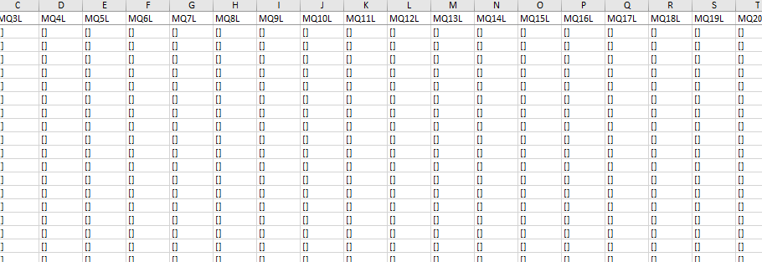
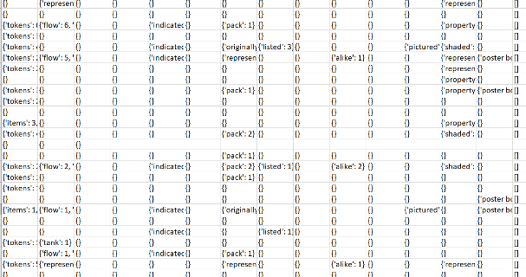
Click Data
LM
GL

Slide 10
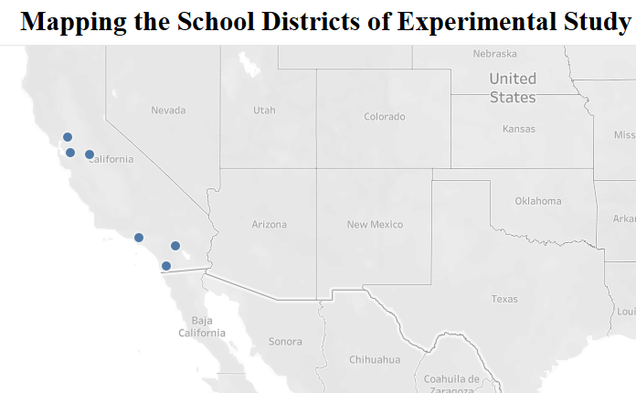
Methods
Recruit total of 23 teachers from 6 schools from California States, each teachers participated in two sessions of assessment.
N=513 from States of California, students (189 ELs and 324 Non-ELs).
There were 220 students were recruited in the accommodation group, and 293 students were in the non-accommodated grou
Gender: 46% female, 54% male
Home language: 68% Spanish
Free/Reduced lunch program: 77%
English language proficiency (ELP):
CELDT Score California English Language Development
Notes:
Test: 5-Scales:
Beginning
Early Intermediate
Intermediate
Early Advanced
Advanced.

Slide 11
Research Question 1
Are the accommodations effective for increasing the mathematics performance of the EL students in standardized assessment?
Multiple t test
Bifactor CFA model

Slide 12
Table 1
Descriptive Results of Mathematics score for ELL and non-ELL by Test accommodations
 |  |  | ELL |  |  |  |  |  | Non-ELL
Test Accommodation |  | N | Mean |  | SD |  | N |  | Mean |  | SD
Non-accommodated | 81 |  |  | 9.86 |  | 0.50 |  | 139 |  | 10.50 |  | 0.42
Linguistic Modified | 69 |  |  | 10.29 |  | 0.57 |  | 143 |  | 12.70 |  | 0.36
English Glossary | 39 |  |  | 8.33 |  | 0.58 |  | 42 |  | 8.98 |  | 0.73
Total | 189 |  |  | 9.61 |  | 0.32 |  | 324 |  | 11.64 |  | 0.26
Note. English Readaloud is not used since only 9 students were assigned to the group.
Notes:
The original there are 5 accommodation, through the identify system testing, here sort out the 2 accommodation out of the three

Slide 13
Student’s Multiple t Test comparing the mean of the accommodated and the English mathematics test for the EL group (n = 189)
.
Test Type | Mean |  | SD | Student’s Multiple t-Test | P
Linguistically Modified | 10.29 | 0.50 |  | 1.02 | 0.08
English Glossary | 8.33 | 0.57 |  | -1.11 | 0.23
Non-accommodated | 9.68 | 0.32

Slide 14

EL Performance on Math, Language, or Both?
Identify the best-fitting latent model that would reflect the underlying construct(s) of the non-accommodated and Linguistic-Modified mathematics assessment forms.
Non-accommodated version: single-factor model
Linguistic modified version: bi-factor model
Two Latent factors (General Math, language proficiency).
Measurement Invariance: All items represent both “general mathematics skills” and “English language complexity.”

Slide 15
Two Factor Confirmatory Path Model
Good Model Fit
RMSEA < 0.05
CFI > 0.95
TLI > 0.95.
P >.05
Cronbach alpha Reliability = >.60
Average loading > .70;
General Math
Linguistic-complexity
math1
……
math12
……
math13
……
math14
……
math25
math26
E1
E1
E1
E1
E1
E1

Slide 16
Table 5. Estimated Factor Mean Difference between EL and Non-EL students on the Standard and LM Forms
Form | Model | Construct | Mean Diff. (Reference – Focal) | p | Effect Size
Non-Accommodated | Single Factor | General Math | -.24 | .000 | .25
Linguistic-Modified | Bifactors | General Math | -.36 | .001 | .37
 |  | Language Complexity | .09 | .614 | .09
The results indicated the bifactor model has better model fitting index than the single factor model
The model fit of Linguistic Modified form improved the model fit significantly than the non-accommodated version.
Notes:
Middle school math learning domain
Number system
Expression and equation
Function
Geometry
statistics

Slide 17
Research Question 2
Are there any different across “Linguistic Modified” and “English-Glossary” regarding the accommodations effect on mathematics performance used by ELs, after controlling for SBAC test scores, ELP levels, and ETIMER scores?
ANCOVA
Multiple Regression

Slide 18
ANCOVA of ELs
Variable | df | F | p value | effect size η2
Test Version(Accommodation) | 1 | 0.32 | 0.57 | 0.00
SBAC Math | 1 | 3.95 | 0.05 | 0.04
SBAC Reading | 1 | 1.80 | 0.18 | 0.02
CELDT | 1 | 9.28 | 0.00 | 0.09
English Timer | 1 | 1.72 | 0.19 | 0.02
Test Version * SBAC Math (INT1) | 1 | 0.29 | 0.59 | 0.00
Test Version * CELDT (INT2) | 1 | 0.21 | 0.64 | 0.00
Test Version * English Timer (INT3) | 1 | 0.04 | 0.85 | 0.00
Test Version * SBAC Math * CELDT(INT4) | 2 | 3.30 | 0.04 | 0.06
Test Version * SBAC Read * CELDT(INT5) | 2 | 1.65 | 0.20 | 0.03
Test Version * SBAC Math * SBAC Read * CELDT * English Timer (INT6) | 2 | 0.66 | 0.52 | 0.01

Slide 19
Results
No statistically significant accommodation effects.
SBAC Math and CELDT scores were significant predictors of EL’s math scores (with small effect)
INT4: ELs with SBAC math and CELDT score who are using accommodations predict Math test score.
INT5: ELs with high SBAC read and high CELDT score who are using accommodations gained high Math test score.

Slide 20
Research Question 3
Do the accommodations have construct validity without impacting the non-EL students’ performance.
The similar ANCOVA is applied

Slide 21
ANCOVA Results of Non-ELs
Variable | df | F | p value | Effect Size (η2)
Test Version | 1 | 4.84 | 0.05 | 0.06
SBAC Math | 1 | 1.51 | 0.22 | 0.02
SBAC Read | 1 | 0.04 | 0.84 | 0.00
English Timer | 1 | 0.29 | 0.59 | 0.00
Test Version * SBAC Math (INT1) | 1 | 5.17 | 0.03 | 0.07
Test Version * English Timer (INT2) | 1 | 0.48 | 0.49 | 0.01
Test Version * SBAC Math * SBAC Read * English Timer (INT3) | 2 | 0.42 | 0.66 | 0.01
Notes:
Why they should not alter the non-EL students, because assume the two factor of math and language, but language are impacted by the accommodation of EL, therefore, they test score should not

Slide 22
Results
Construct validity was warranted
Non statistically significant accommodation effects for non-EL’s Math.
INT1: non-ELs with SBAC math who are using accommodations predict the Math test score.

Slide 23
Research Question 4
What is the relationship between the using “Linguistic Modified” and “English-Glossary” accommodation and the response time by the ELs?
Explore the Item properties of different accommodations and their impact on how the ELs usage decision.
Comparing the math performance (p-value) of each item among the Linguistic-Modified, English Glossary and non-accommodation of ELs.
Compare the correlation between math performance (p-value) and response time of the three groups for ELs.

Slide 24
Table 1
Item-Level Response Time in Second for the Accommodation and Non-Accommodation Groups
 |  | ELL |  |  | Non-ELs
Test Accommodation | N | Mean | SD | N | Mean |  | SD
Non-accommodated | 81 | 1019.69 | 0.86 | 139 |  | 1277.39 | 0.42
Linguistic Modified | 69 | 1103.73 | 0.66 | 143 |  | 1273.82 | 0.36
English Glossary | 39 | 881.00 | 0.09 | 42 |  | 1122.13 | 0.73
Total | 189 | 1019.07 | 0.32 | 324 |  | 1253.43 | 0.26
Notes:
The original there are 5 accommodation, through the identify system testing, here sort out the 2 accommodation out of the three

Slide 25
ANCOVA of Response Time ELs
Variable | df | F | p value | effect size η2
Test Version(Accommodation) | 1 | 0.07 | 0.79 | 0.00
SBAC Math | 1 | 0.38 | 0.54 | 0.00
SBAC Reading | 1 | 2.54 | 0.11 | 0.03
CELDT | 1 | 4.62 | 0.03 | 0.05
English Timer | 1 | 4.84 | 0.03 | 0.05
Test Version * SBAC Math (INT1) | 1 | 0.12 | 0.73 | 0.00
Test Version * CELDT (INT2) | 1 | 0.18 | 0.68 | 0.00
Test Version * English Timer (INT3) | 1 | 0.77 | 0.38 | 0.01
Test Version * SBAC Math * CELDT(INT4) | 2 | 0.68 | 0.51 | 0.01
Test Version * SBAC Read * CELDT(INT5) | 2 | 2.07 | 0.13 | 0.04
Test Version * SBAC Math * SBAC Read * CELDT * English Timer (INT6) | 2 | 2.36 | 0.10 | 0.05

Slide 26
Results
The descriptive analysis indicated the linguistic modified accommodation effectively reduced the EL’s response time, which means the modified version makes the test less time-consuming.
However, the Glossary is expected to take the EL’s longer time to process, which indicated the EL’s did not use the glossaries sufficiently.
No statistically significant accommodation effects on the response time.
SBAC Math and CELDT scores were significant predictors of EL’s Response time (with small effect)

Slide 27
Table Comparison of Average Response Time Between Non-accommodated and Linguistic Modified for ELs
Item # | Non-accommodated |  | Linguistic modified |  | Significance
 | Mean | SD | Mean | SD
Q7 | 22.85 | 0.39 | 28.88 | 0.37 | 0.01
Q8 | 37.19 | 0.42 | 32.04 | 0.46 | 0.01
Q14 | 32.76 | 0.42 | 20.90 | 0.48 | 0.00
Q19 | 52.25 | 0.47 | 43.69 | 0.49 | 0.00
Q20 | 26.31 | 0.47 | 21.01 | 0.49 | 0.00
Q22 | 31.05 | 0.39 | 26.15 | 0.44 | 0.00
Notes:
52.25

Slide 28
Table Comparison of Average Response Time Between Non-accommodated and English Glossary for ELs
Item # | Non-accommodated |  | English Glossary |  | Significance
 | Mean | SD | Mean | SD
Q7 | 22.85 | 0.39 | 14.96 | 0.37 | 0.01
Q8 | 32.04 | 0.42 | 17.80 | 0.46 | 0.03
Q9 | 46.86 | 0.48 | 62.26 | 0.50 | 0.01
Q10 | 31.10 | 0.32 | 23.06 | 0.48 | 0.00
Q13 | 42.86 | 0.45 | 33.26 | 0.03 | 0.00
Q19 | 43.69 | 0.47 | 25.23 | 0.79 | 0.00

Slide 29
Results
A small difference in response time across the three groups.
Item 7, 8, 14, 19, 22 shows the linguistic items takes significantly lower than the non-accommodated groups for ELs.
Only Item 9 shows the Glossary takes longer than the non-accommodated group.
Item 7 has 5 LM and 2 Glossary, in total 7 accommodations;
Item 22 has 14 accommodation with 6 LM and 8 Glossary which likely to extend the response time.
Both Item 14, 19 have 4 LM;
Item 9 has 7 Glossary which is likely to extend the response time.
All the statistically significant items are moderate to low difficulty level which favor the effectiveness of the accommodation.

Slide 30
Exploring Item Characteristics in Relation to Response Time (ELs)
Q13: Relatively high difficulty; but only 4 linguistic modified, non-Glossary are used,
Q4: Relatively moderate difficulty, multi-part item (graphic)
Q19: Relatively high difficulty, 4LM are used
Q8: Relatively moderate difficulty, but high language demands (no graphic)
Q24: low difficulty, 4LM and 7 glossed words are used

Slide 31
Comparison of EL Math Performance (p-value) Among Non-accommodated, Linguistic-Modified and English Glossary (16 items)
Q12: moderate difficulty with 4 glossed words are used
Q29: moderate difficulty with 7 LM and 5 glossed words are used

Slide 32

Relation Between the Response Time and Accommodation Number

Slide 33
Results
There was statistically significant relationship found between the response time and accommodation numbers of the linguistic modified. The more LM applied, the lower the response time should be.
The results align with the study by Roohr and Sireci that LM can reduce the cognitive load of EL so as to shorten their test taking time.
However, only 5 out of 30 items showed practically statistically different in response time on the math test.

Slide 34


Relation Between the Math Overall Performance and Accommodation Numbers
$R^{2}$ = 0.42

Slide 35
Results
There was a statistically significant relationship found between the response time and mathematics overall performance (p-value) on the Linguistic-modified and non-accommodation group, but not in the English Glossary groups.
This can be explained that the English Glossary is not sufficiently used by the ELs with the reduced response time.

Slide 36

Relation Between the Math Overall Performance and Response Time

Slide 37
Results
There were statistically significant relationships found between the response time and math overall performance on the linguistic modified. The math overall performance is negatively correlated to the response time.
There was no statistically significant relationship between the non-accommodated group and response time. None of the evidence shows the longer the students spend on the test item, the better their math score.
This is consistent with the empirical studies that the student's disengagement in the test or skip the question can not reflect their mastery of the test (Kopriva, 2017).
There is no statistically significant relationship between the response time and math overall performance for the glossary. None of the evidence shows that the longer time they spend on reading the glossary text, the better their math test score.
The results are not surprising that only one item shows the statistically significant longer response time than the non-accommodated group.

Slide 38
Conclusion
Although we didn’t find the statistically significant difference that accommodated performed higher than the non-accommodated ELs on a math test, the results show the statistically significant interaction effects. With relative math and ELP levels, the ELs are expected to improve math performance with the accommodation.
The results show some important covariate effects. After covariate English Timer was added to the regression model, the linguistic modified become the significant predictors of the math test.
The results demonstrated the validity of the study that the accommodation did not affect non-EL’s math test.

Slide 39
Conclusion
None of the consistent trends was found in the relation between the increased number of accommodation and response time, suggesting that the students’ response time might be related more to the computation time and mathematical reasoning rather than the accommodation use.
The item difficulty still plays a large role in the response time of ELs, which decreases the accommodation effect.
Determining the EL’s English proficiency and prior math, reading proficiency levels can be helpful to assign the EL’s for appropriate accommodations.

Slide 40
Implication
The results didn’t tell the information about how the students use the accommodation but indicated more time is needed to process the accommodation and impact the test results.
There are only multiple items that show the statistically significant higher responses time of accommodated than the non-accommodated groups of ELs. The CBT designer needs to improve the item properties to engage the students using accommodations.
The study implies that the test content is too difficult for Grade 8 students. The policymakers and stakeholders should address the content difficulties to develop and new assessment and make the accommodation favor the EL’s needs.

Slide 41
Limitation
The small sample size did not represent the diverse population of EL middle school students.
The test is difficult with highly positively skewed distribution. For instance, the test has very low reliability (Cronbach alpha) with an internal consistency coefficient of 0.60 and low discrimination power.
The SBAC overestimates the EL’s performance which impacts the accommodation usage to benefit the students. The current data indicated the test properties should be improved to align with ELs’ performance.
The mathematics test was implemented through the low API schools with the various pace of instructing the units of Common Core State Standards. Therefore, the teachers might not ready for the newly designed-assessment system to accommodate the student test needs.

